Slide 1
Apache Kafka
Rajasekhar Reddy V

Slide 2
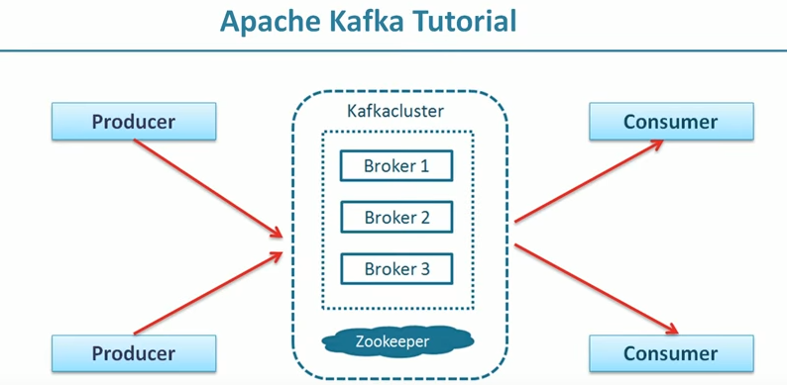
Apache Kafka

Slide 3
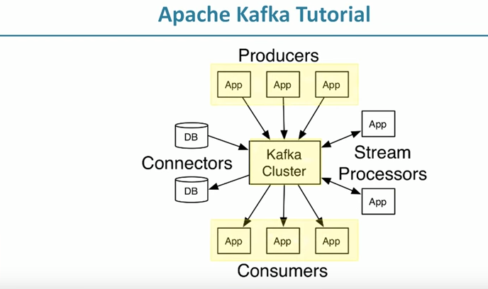

Slide 4
Producer applications sends requests to Kafka cluster
Kafka cluster is nothing but a group of brokers running on different systems(computers)
Brokers take producer message records and store it in Kafka message log
Consumers read messages from Kafka cluster and process it and store it in HBase, Cassandra ,Hadoop or Mongo DB Or send it back to Kafka to others use it and update or modify.
stream processors read continues stream of messages data from Kafka and process the data and send them back to Kafka or send them directly to other systems.

Slide 5
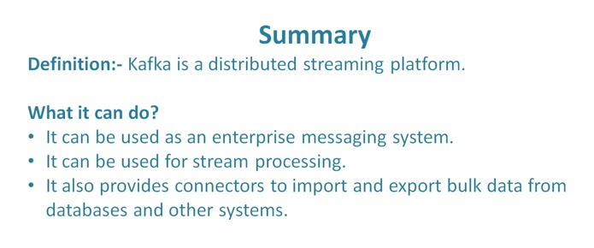
Connectors are powerful feature of Kafka and used to export data from database or other systems and put it in Kafka or import data from Kafka and send it to database or other systems.

Slide 6
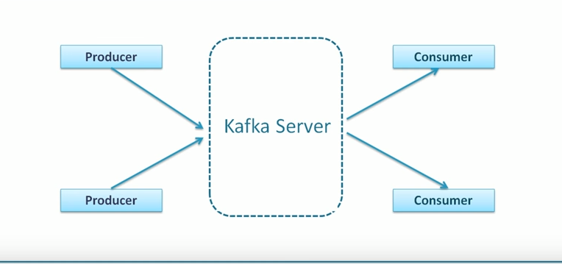

Slide 7
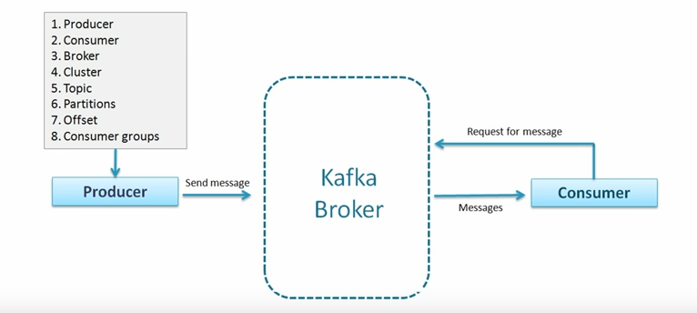

Slide 8
Kafka server is nothing but Broker to exchange data between producer applications and consumer applications.
What is a cluster?
Cluster is a group of computers sharing workload for a common purpose.
Each computer is executing one broker.

Slide 9
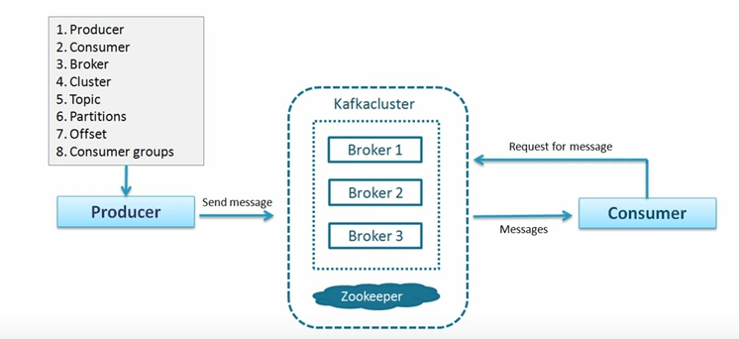

Slide 10
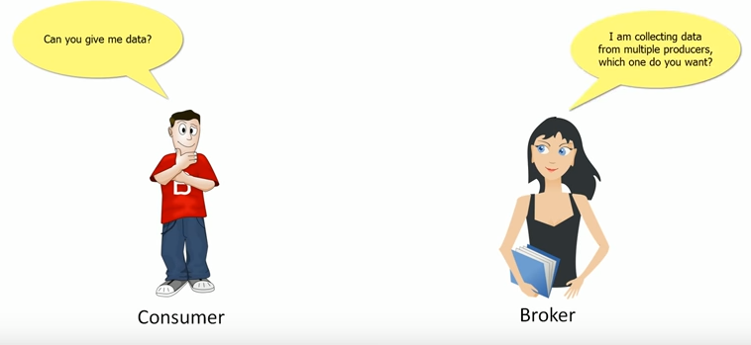
Topic:

Slide 11
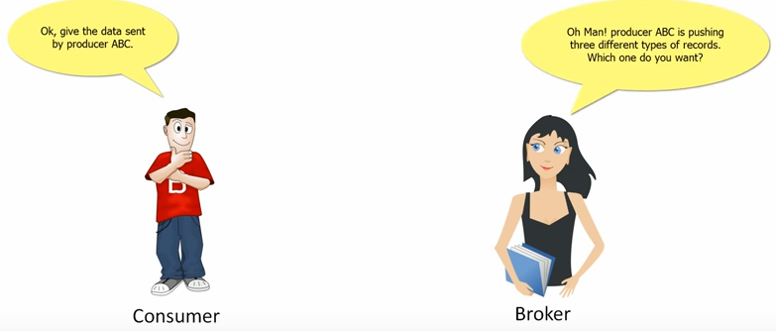

Slide 12
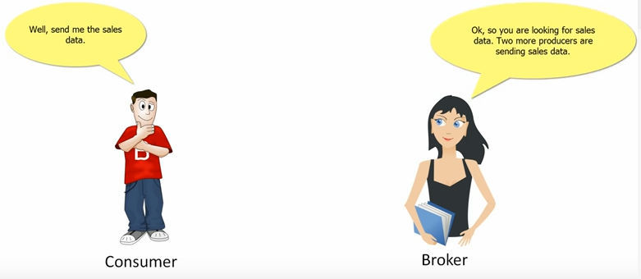

Slide 13
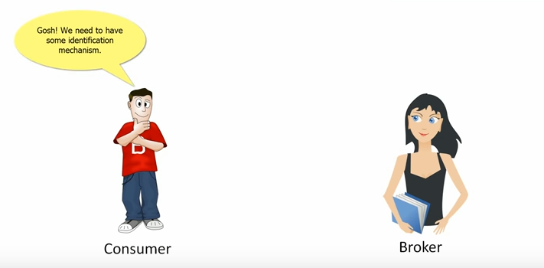

Slide 14
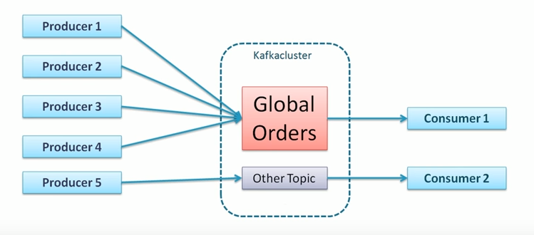
What is a topic?
Topic is a unique name for Kafka stream or data stream.

Slide 15
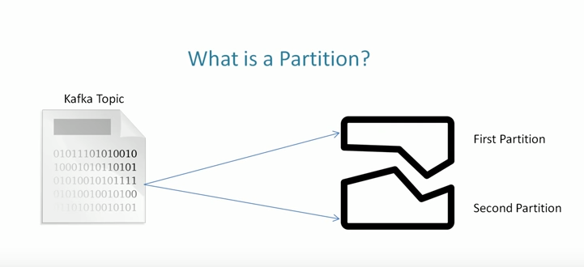
What is a patriation?
Broker will store data for a topic and this data can be a huge and it may be a larger capacity than a single computer capacity.
In this case broker may have a challenge to store data for topic.
Broker stores data in Array of bytes.

Slide 16
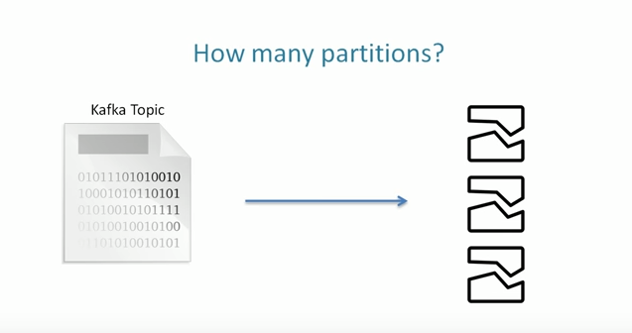
Now one of the obvious solution is that break topic in to multiple partitions and distribute it to multiple systems(computers).
Kafka is a distributed system that runs on a cluster of computers.

Slide 17
Kafka will not take decision for how many partitions required for a topic some may are big topics and some may are small topics.
1
So we have to decide how many partitions are required then Kafka broker will create that many partitions for a topic.
2

Slide 18
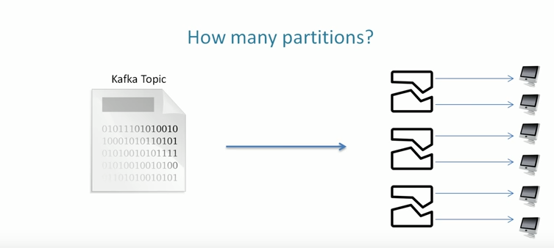
After partitioning a topic each partition will sit in a single machine and we can't break again.

Slide 19
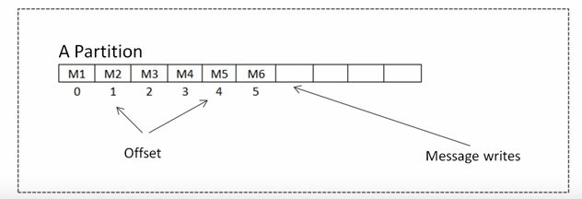
Offset
What is offset?
A sequence id given to messages as they arrive in a partition.
Once id is assigned they never change(immutable) and there is no global offset across each partition.
Offsets are local to the partitions.

Slide 20
So if you want to locate a message you must know 3 things.
1
Global Unique Identifier of a message?
2
Topic Name ->Partition Number ->Offset

Slide 21
Consumer group:
What is a consumer group?

Slide 22
A group of consumers acting as a single logic unit.

Slide 23
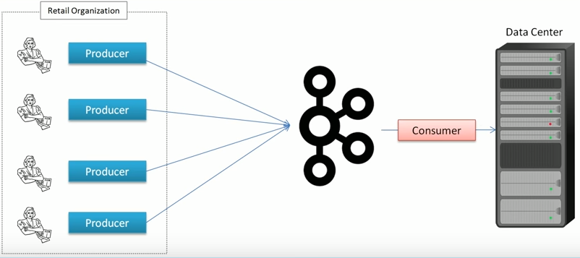

Slide 24
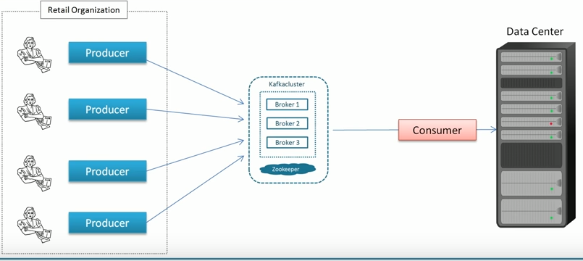

Slide 25
